Slide 1
Social interventions: Vulnerable children

Slide 2
Program
Municipality
Principles
Interventions: child and family
Family Conference
State
National program: Prevention, discovering and handling in cases of sexual abuse and violence towards children

Slide 3
Principles and frames for social interventions towards vulnerable children
Principles
Minimum intervention
Work towards normality (family, school, spare time activities)
Involvment of the child and the family
Network is involved
Focus on health and education
Notes:
Developments in Denmark: From: Big institutions - normalization through punishment / consequences pedagogy. Impersonal relationships, group education (Makarenko). Far away was an end in itself, to remove the child from the problem (in the family and environment). Research shows that children who grew up on the big orphanages do not fare so well in life. Learning, role models, relationships ... Children who spent their early years in an institution is injured: attachment, cognitive functions. Now: Children should as far as possible keep in touch with their parents. Placing not too far away from their parents. We try to involve network families. Foster care in the municipalities. Prioritize schooling, spare time activities (sport etc.)
**
A few examples.

Slide 4
Interventions based on research
Child development
Psycology
Fysiology
Sociology
Notes:
ICS

Slide 5
Child protection: interventions
Counseling
Economical help
Psychological help
Practical help and guidance
Boarding school
Youth-workers support and guidance
Out-of-home-placement

Slide 6
Out-of-home placement
Network foster care – the child is placed with foster-parents from its larger network
Kinship foster care – the child is placed with relatives, typically grandparents
Foster care, other – all other foster care placements: the child is placed with foster parents that are neither relatives, nor from the child’s network
Own room – young people placed in a flat, typically under supervision and with support from a municipal contact person.
Notes:
Why, when and how?
Where?
How long time?

Slide 7
Out-of-home placement
Municipal residential care – public residential care facilities for children with grave social and psychiatric difficulties
Acute institutions – residential care facilities that receive children and young people at short notice
Secure residential care or secure accommodation – locked residential facilities for young people with a variety of very serious difficulties, offenders, etc., especially used for young people in custody
Municipal residential care – public residential care facilities for children with grave social and psychiatric difficulties
Acute institutions – residential care facilities that receive children and young people at short notice
Secure residential care or secure accommodation – locked residential facilities for young people with a variety of very serious difficulties, offenders, etc., especially used for young people in custody
Residential care, other – covers non-municipal institutions, e.g. state institutions for disabled children and private residential care.

Slide 8
Aftercare assistance
pathway plan,
individual monitoring,
housing,
financial allowances, benefits,
support with education and training,
support with getting and maintaining a job,
life-skills training,
psychological counseling,
health services,
support with special needs (disability, pregnancy, childcare),

Slide 9
Child protection: conclusion
The focus on the individual is explicitly stated in the Law of Social Services.
It is safeguarded by the legally established complaints procedures and bodies, non-governmental support networks and the social pedagogic approach to care.
The rights of the child in residential care institutions are ensured mainly through the individual action plan, which is based on the assessment of the child’s/young person’s problems and available resources.
The plan is to be revised regularly with the participation of the child/young person.
All decisions with regard to the child’s/young person’s placement and transition are taken with the consent of that person and their parents.

Slide 10
Family Group Conference
A method in social work
Developed in New Zealand
Theoretical background:
Ecological system-theory
Social networking theory
Empowerment
In Denmark:
“A model for communication and decision with clear framework and predefined questions, where the extended family in a private room will decide on the aid to be granted from the public and / or family for the child / young person's well-being and development. Administration approves subsequent action plan and the follow-up.”
(Rasmussen and Hansen, 2002, Mortensen 2007)
Notes:
The starting point was ethnic inequality. Developed in the 1980s in New Zealand as it became clear that Maori children in disproportionate numbers were placed outside home. "A formal meeting of members of the family group (...) to discuss, often with social workers, what needs two be done two make sure a child or young person is safe and cared for" In the Danish Law of Social Service it is emphasized that the involvement of the child, family and network is an important basis for achieving the objective of social action. Family Group Conference can be such a method that can promote the intentions of increased legal certainty for the children, young people and their families, better the knowledge base and enable a resource orientation. The principle of Family Group Conference - and how it differs from other ways of making decisions: The extended family is actively involved in decision making. The authority to formulate an action plan is submitted to the extended family, which formulates it, without any professional present. The family's participation is supported by a neutral person (a partner / coordinator), engaged to coordinate the conference. Use of questions: Before the Family Group Conference is held some questions have been formulated which the family must consider in relation to an Action Plan. There is also pre-formulated a framework within which the action plan must respect. To ensure focus on the child. Caseworker keeps the authority by formulating the questions and because she shall approve and follow-up.

Slide 11
Family Group Conference: Phases
Explore needs Start family conference Follow up
Specific need identified Family conference Proposals/questions
Preparation
1 2 3
Follow up
Notes:
Source: UFC Children and Families, study on Family Group Conference in Denmark, 2001
In each phase there are key tasks to be carried out. The preparation stage: agreement between the family and the coordinator about the Family Group Conference. Finding out what is needed for the decision. Study of the problem and definition of the problem, so that you can define questions. For the meeting itself, there must be: Preparation of paper with information about the issues. Appointment of persons in the network to control the meeting and support the child. The responsible professional / social worker must approve the action plan, the network has formulated. After the meeting. Agreements on follow-up and how the plan and the process must be evaluated.

Slide 12
Serious cases about abuse in Denmark Intervention from the Parliament: The child abuse program

Slide 13
Three sectors involved in cases on abuse aginst children
Social services
The municipalities
Health care
The health sector in regions
Punishment, Criminal law
The Police
Notes:
For induction: Why are these cases are often difficult to handle. Because of the complexity of the problem and because there are several sectors involved. Lack of cooperation. We work in the social field, but the interdisciplinary and intersectoral cooperation is necessary in cases of violence and abuse: When abuse cases are difficult to handle, it's partly because we have three sectors with different laws with different focus involved in many of the cases. It is the task of the police to investigate whether there is a criminal act - and if so, to prosecute it. It is the task of the health care to examine whether the child has suffered physical injury - and if so treat them (and also to find possible evidence for a possible prosecution). It is the social service’s task to examine and assess whether the child because of what it has been exposed to have special difficulties and needs - and if so, to take the necessary action. Futher more they have to take care, that the child is safe from futher assault. It is important, that no administrative body can solve cases of violence and sexual abuse alone. As the circles indicates there are areas of collaboration between the areas. It highlights the need for good coordination and clarity about their own and others' roles. The interdisciplinary cooperation is a major challenge in these cases and is sometimes also the reason why the focus is not sufficiently on the child.

Slide 14
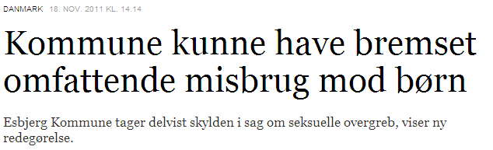
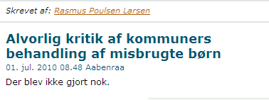
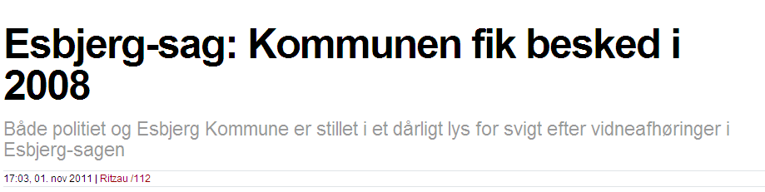
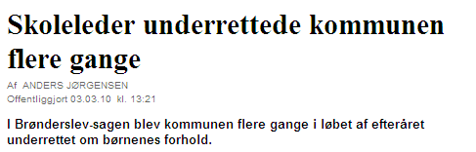
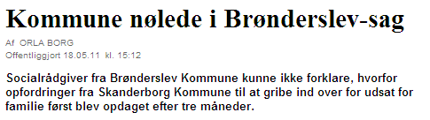
Focus on abuse
Notes:
Cases:
Brønderslevsagen
Tøndersagen

Slide 15
Coordinated measures to protect children against abuse
Legislation and
many initiatives to support implementation and expand prevention and early intervention. The National Board of Social Service
1
2
3
Developing Policies and Professional guidelines for prevention abuse against children at day care, schools and residential care
Professional guidelines for prevention abuse and handling cases with abuse against children in municipalities
Campaigns targeting children, the general population and professionals on childrens rights
Notes:
Track 1). Prevention and early detection in schools, day centers and residential homes - upgrading of the occupational professional Track 2): legislative: The municipals must have a “preparedness” wich descripe how to report to the authoryties, the municipal approval, among other things how to cooperate between schools, day-care and the social authoryties, and the use of ‘Children's Houses’. The socialworker has to talk to the child, when receiving reproting Track 3): Campaigns targeting children on their rights and information’s to them about where they can get help the general population / adults to focus on violence against children, and where they can get in touch with professionals about their reporting obligations

Slide 16
Prevention in day care, school and residential care
Children
Learning about your own and others boundaries in a social context.
Information and education about children's rights.
Good and safe environment for the children in the school, day care or residential care.
Open dialogue with the children.
Professionals
Clear recruitment and staff follow-up procedures.
Open academic and teaching environment.
Creating dialogue between professionals
Update of knowledge about violence and sexual abuse against children.
Clear procedures in cases with violence and sexual abuse against children.
Parents
Information about the professionals obligations to act.
IInformation and dialogue about the ongoing work with developing a Policy and Professional Guidelines at the day care, school or residential care for children
Policy and Professional Guidelines
in day care, schools and residential care
- A dynamic policy
Notes:
Professionals
Clear recruitment and staff follow-up procedures.
Open academic and teaching environment.
Creating dialogue between professionals
Update of knowledge about violence and sexual abuse against children.
Clear procedures in cases with violence and sexual abuse against children.
Children
Learning about your own and others boundaries in a social context.
Information and education about children's rights.
Good and safe environment for the children in the school, day care or residential care.
Open dialogue with the children. How do we make our self available for the children?
Parents
Information about the professionals obligations to act.
Information and dialogue (involvement) about the work with the Local Professional Guidelines

Slide 17
Professionals - teachers, and social workers
Professionals
Clear recruitment and staff follow-up procedures.
Open academic and teaching environment.
Creating dialogue between professionals
Update of knowledge about violence and sexual abuse against children.
Clear procedures in cases with violence and sexual abuse against children.

Slide 18
Children
Children
Learning about your own and others boundaries in a social context.
Information and education about children's rights.
Good and safe environment for the children in the school, day care or residential care.
Open dialogue with the children. How do we make our self available for the children?

Slide 19
Parents
Parents
Information about the professionals obligations to act.
Information and dialogue about the ongoing work with developing a Policy and Professional Guidelines at the day care, school or residential care for children.

Slide 20
”Preparedness”
Before the assault/abuse
Prevention programs and early descovering
During
The time from the abused has rapported to the child is in the Childrens House
After
Social interventions, social supporting and teatment to the child and family after beeing in the Childrens House
Before
During
After
Notes:
A written ”prepareness”, descpriping procedures for cooperation between different professional groups and between different sectors.

Slide 21

Organizing the system in Denmark
The Children’ Houses
The state/Socialstyrelsen as a co-ordinating and
facilitating body
Social services
The municipalities
‘Children’s Houses’
Health care
The health sector in regions
Punishment, Criminal law
The Police
Notes:
A model for ‘Children's Houses’ in Denmark The five ‘Children’s Houses’ shall strengthen the interdisciplinary and intersectoral cooperation in cases of abuse of children and ensure that children are heard and examined in a child-friendly environment. Organizational: Inter-municipal cooperation - with five geographically distributed municipalities operating the houses. Financed by the state Co-ordination by the state (National Board, SISO), including documentation / data recording and collection, description of professional standards and methods Tasks: Police Questioning by specially trained police officers Possibly forensic examination Assessment / Specific examination of the children by specially trained social workers and psychologists - in cooperation with local social workers. Decision-making and paying for any support or treatment is in the municipality

Slide 22

The ‘Children’s Houses’
Legislation:
Obligates the municipalities to use the houses in cases of abuse and violence against children or when in doubt.
The aim of the ‘Children’s Houses’:
A coordinated and gentle interdisciplinary effort concerning
assessment
investigation
examination, and
crisis intervention.

Slide 23
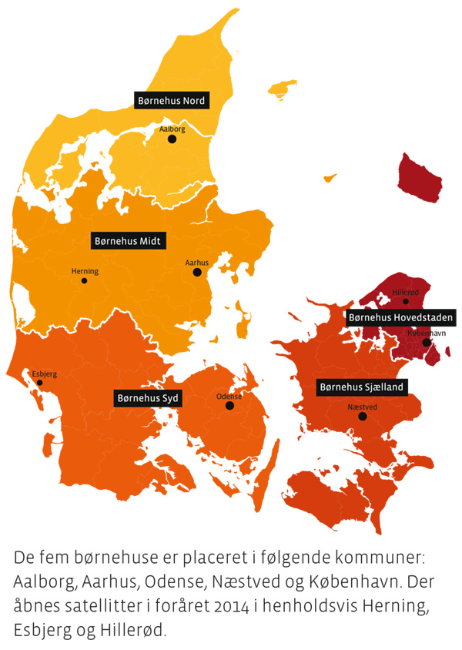

Slide 24

Prevention, discovering and handling of sexual assault and child abuse? - What is needed?
Notes:
Knowledge – Openness – Dialogue - Action
Concluding:
4 Cornerstones if we are going to be better to prevent, to discover and to handle violence and sexual abuse toward children: It requires a basic professional knowledge about violence and its impact on children, and on the signs and reactions you have to be aware of. The expertise must have a child perspective to ensure that the signals are seen and understood in relation to the specific context in which the child is situated, as well as in the child's overall living conditions. You also have to hav knowledge of the barriers that exist - both for the professional and for the children - which can lead to that the violence is not seen, heard, articulated and assessed. So it requires professional openness. An important point is that you shall not too early either reject or one-eyed insists that a child do not thrive due to violence. Instead, you must practice an open approach to the cause of the failure to thrive. A professional open approach is based on the fact that violence can be one of several possible explanations when assessing a child's failure to thrive. A third element is that you as a professional is prepared to engage in a professional dialogue with other specialists about concerns or suspicions of violence. The importance of engaging in professional dialogue with colleagues, partners and children themselves is central to an early and qualified tracing. And that is what a part of this module is about. Finally, as a fourth element, it is crucial that professionals know about the possibilities and obligations to take the right action when there is suspicion of abuse. It is important for the handling of these cases that you act in the right way and at the right time.

Slide 25
Working in groups to produce material you can use as trainers
Early discovering:
How can You reach these particularly vulnerable children in Kyrgyzstan?
How can You prepare both the common population and the professionals?
Are there specific challenges?
Procedures and cooperation between professionals:
Do You need to make new or qualify existening guidelines and procedures?
Notes:
How can you reach these particularly vulnerable children in Kyrgyzstan?
Specific geographical challenges? (Isolated areas in the countryside, in the mountains?)
Can campaigns be used? How?
Can teaching materials be developed and used?
Can volunteers be involved? How?

